Slide 1
Lecture 7
Topics: Objects and Classes, Part III
Chapter 9, Sections 9.10 – 9.14

Slide 2
A quick review of how objects are stored

Slide 3
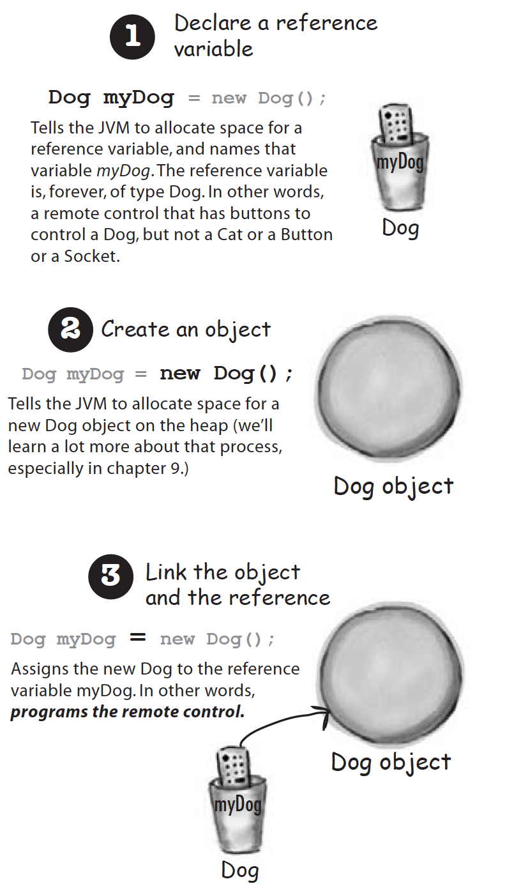
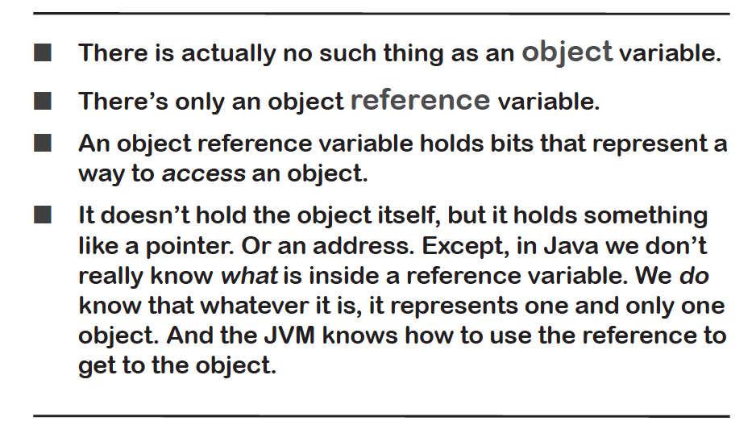

Slide 4
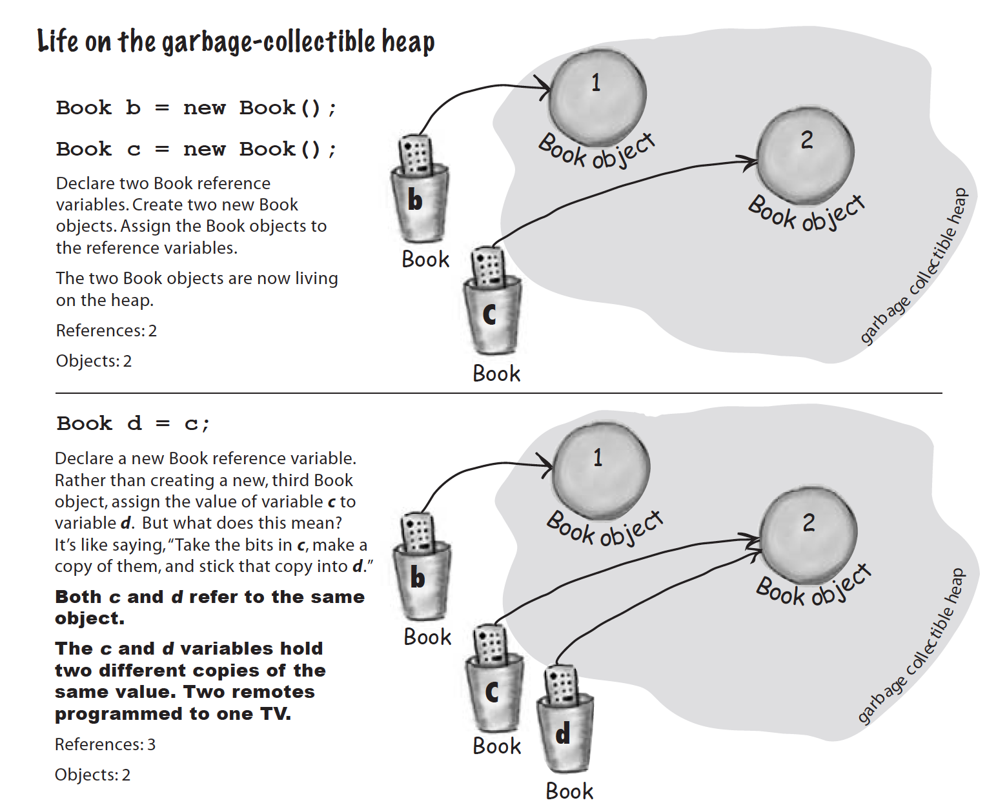

Slide 5
public class Book
{ public String title; public int pages; public void printBookInfo()
{ System.out.println(this.title + " has " + this.pages + " pages."); } }
public class BookTest
{ public static void main(String[] args)
{
Book c = new Book();
c.title = "War and Peace";
c.pages = 2398;
c.printBookInfo();
Book d = new Book();
d = c;
d.title = "The Brothers Karamazov";
d.printBookInfo();
c.printBookInfo(); } }
Memory (stack)
Memory (heap)
(Book)
title:
pages: 0
c
War and Peace
The Brothers Karamazov
d
2398
Output
War and Peace has 2398 pages.
The Brothers Karamazov has 2398 pages.
The Brothers Karamazov has 2398 pages.
(Book)
title:
pages: 0

Slide 6
What about equality?
What happens if you try and compare two objects of the same type (i.e. both Book types) using the == operator?
Book b = new Book();
b.title = "Happy";
b.pages = 234;
Book c = new Book();
c.title = "Happy";
c.pages = 234;
if (b == c)
System.out.println("They’re the same!");
else
System.out.println("Alas, different books.");
Stack
Heap
(Book)
title:
pages:
b
Happy
234
(Book)
title:
pages:
c
Happy
234
b does not equal c! Why? They have the same data fields?!
The == operator checks to see if they have the same place in memory (i.e. memory addresses are equal).
For primitive types, a variable of that type actually contains a value of that type, whereas reference variables (for objects) contain a reference to an address.

Slide 7



How do I check for object equality?
Holy cow! You can create methods
that have class type parameters! You
can pass a Book object into the method.
public class Book
{ public String title; public int pages; public void printBookInfo()
{ System.out.println(this.title + " has " + this.pages + " pages."); }
public boolean isEqual(Book b)
{
boolean equal = false;
if ((this.title.equalsIgnoreCase(b.title)) && (this.pages == b.pages))
equal = true;
return equal;
}
}

Slide 8
Passing objects to methods
Passing an object to a method passes the reference of the object.
What is pass by reference?
Analogy: Let’s say I want to share a web page with you. If I tell you the URL, I'm passing by reference. You can use that URL to see the same web page I can see. If that page is changed, we both see the changes. If you delete the URL, all you're doing is destroying your reference to that page - you're not deleting the actual page itself.
Pass by value: If I print out the page and give you the printout, I'm passing by value. Your page is a disconnected copy of the original. You won't see any subsequent changes, and any changes that you make (e.g. scribbling on your printout) will not show up on the original page. If you destroy the printout, you have actually destroyed your copy of the object - but the original web page remains intact.

Slide 9
public class Test
{
public static void main(String[] args)
{
double h;
Shoe s1 = new Shoe(3.5);
h = s1.getHeight();
System.out.println(h);
changeIt(s1);
h = s1.getHeight();
System.out.println(h);
}
public static void changeIt(Shoe s)
{
s.setHeight(5.1);
}
}
public class Shoe
{
private double height;
public Shoe(double h)
{
this.height = h;
}
public double getHeight()
{
return this.height;
}
public void setHeight(double h)
{
this.height = h;
}
}
Output
3.5
5.1
Main(stack)
Heap
h
s1
: 3.5
: 5.1
height: 0
3.5
5.1
changeIt (stack)
s

Slide 10

With objects

Slide 11
And arrays can hold objects!
Arrays can hold objects as well as primitive type values.
An array of objects is actually an array of reference variables.
When you declare and create an array of objects, the array has values of null until you initialize it.

Slide 12


Example
public class Dog
{
private String name;
public Dog(String dogName)
{
this.name = dogName;
}
public String getName()
{
return this.name;
}
}
public class TestDog
{
public static void main(String[] args)
{
Dog dog1 = new Dog("Skippy");
Dog dog2 = new Dog("Gena");
Dog dog3 = new Dog("Flipper");
Dog[] dogArray = {dog1, dog2, dog3};
S.O.P.L("Dog 0 is: " + dogArray[0].getName());
S.O.P.L("Dog 1 is: " + dogArray[1].getName());
S.O.P.L("Dog 2 is: " + dogArray[2].getName());
S.O.P.L("There are " + dogArray.length + " dogs");
}
}

Slide 13
What is the output?
public class InitializeDogs
{
public static void main(String[] args)
{
Dog[] dogArray = new Dog[4];
for (int i = 0; i < dogArray.length; i++)
{
dogArray[i] = new Dog("Dog" + i);
System.out.println("Dog name: " + dogArray[i].getName());
}
}
}
Memory (stack)
Memory (heap)
dogArray
i: 0
1
2
3
{ , , , }
Dog0
Dog2
public class Dog
{
private String name;
public Dog(String dogName)
{
this.name = dogName;
}
public String getName()
{
return this.name;
}
}
Output
Dog name: Dog0
Dog name: Dog1
Dog name: Dog2
Dog name: Dog3
Dog1
Dog3

Slide 14
Immutable objects and classes
Immutable: Unchanging.
Normally, you create an object and allow its contents to be changed later.
Occasionally, you may want to create an object whose contents cannot be changed once the object has been created (immutable).
To be immutable:
- All the data fields of a class must be private.
- It cannot contain public setter methods for any data fields.
- No accessor (getter) methods can return a reference to a data field that is mutable.

Slide 15
Is the Student class immutable?
public class Student
{
private int id;
private Book book;
public Student(int ssn, Book b)
{
this.id = ssn;
this.book = b;
}
public int getId()
{
return this.id;
}
public Book getBook()
{
return this.book;
}
}
public class Test
{
public static void main(String[] args)
{
Student s = new Student(1212, new Book("1Q84"));
Book b = s.getBook();
b.setTitle("War and Peace");
}
}
public class Book
{
private String title;
public Book(String t)
{
this.title = t;
}
public String setTitle(String t)
{
this.title = t;
}
}
Stack
Heap
s
(Student)
id: 1212
book:
b
(Book)
title: 1Q84
War and Peace

Slide 16
Variable scope
Instance and static variables: The scope is the entire class. In other words, they can be seen anywhere in the class.
Local variables: A variable defined inside a method. It can only be seen within the method.
If a local variable has the same name as a class variable, then the local variable takes precedence and the class variable with the same name is hidden.
Using the keyword this helps to differentiate between instance variables and local variables.
An instance variable can be declared only once, but you can use the same variable name in a method many times in different method blocks.

Slide 17
In-Class Exercise: Cards in a deck
Write a UML diagram and class called Card that has the following:
Two private instance variables: rank (int) and suit (String)
A constructor that takes two parameters and sets the above instance variables appropriately.
Two getter methods for rank and suit.
Write a class called PokerHand with the main method that does the following:
Generates a random number between 1 and 4 corresponding to a suit (1 = Clubs, 2 = Diamonds, 3 = Hearts, 4 = Spades)
Generates another random number between 1 and 13 (1 = Ace, 11 = Jack, 12 = Queen, 13 = King)
Assigns the appropriate values to a Card object.
Stores the Card object in an array of Cards - and does the above steps a total of 5 times.
Prints out the Card values in the Card array.

Slide 18
Card
suit : String
rank : int
+ Card(s : String, r: int)
+ getSuit(): String
+ getRank(): int

Slide 19
public class Card
{
private String suit;
private int rank;
public Card(String s, int r)
{
this.suit = s;
this.rank = r;
}
public String getSuit()
{
return this.suit;
}
public int getRank()
{
return this.rank;
}
public void printCard()
{
S.O.P.L("Card " + i);
S.O.P.L("Suit: " + this.getSuit());
S.O.P("Rank: ");
if (this.rank == 1)
S.O.P.L("Ace");
else if (this.rank == 11)
S.O.P.L("Jack");
else if (this.rank == 12)
S.O.P.L("Queen");
else if (this.rank == 13)
S.O.P.L("King");
else
S.O.P.L(rank);
}
}
public class PokerHand
{
public static void main(String[] args)
{
int r1, r2;
String suit;
Random randGen = new Random();
Card[] cardArray = new Card[5];
for (int i = 0; i < cardArray.length; i++)
{
r1 = randGen.nextInt(4) + 1;
r2 = randGen.nextInt(13) + 1;
suit = findSuit(r1);
cardArray[i] = new Card(suit, r2);
}
for (int i = 0; i < cardArray.length; i++)
{
cardArray[i].printCard();
}
}
public static String findSuit(int n)
{
String suit;
if (r1 == 1)
suit = "Clubs";
else if (r1 == 2)
suit = "Diamonds";
else if (r1 == 3)
suit = "Hearts";
else
suit = "Spades";
return suit;
}
}

Slide 20
In-Class Exercise: Quadratic Equations
Write a UML diagram and class called QuadraticEquation, to solve quadratic equations (ax² + bx + c = 0), that has the following:
Private double instance variables: a, b, and c
A constructor that takes three double parameters and sets the above instance variables appropriately.
Three getter methods for a, b, and c.
A method named getDiscriminant() that returns the discriminant: b² – 4ac
Two methods named getRoot1() and getRoot2() for returning the roots (if the discriminant is negative, return 0 for the roots)
A method named printResult() that prints “The equation has no roots” if the discriminant is negative and prints the roots (r₁ and r₂) if the discriminant is positive.

Slide 21
QuadraticEquation
a : double
b : double
c : double
+ QuadraticEquation(a : double, b: double, c : double)
+ getDiscriminant(): double
+ getRoot1(): double
+ getRoot2(): double
+ printResult(): void

Slide 22
public class QuadraticEquation
{
private double a, b, c;
public QuadraticEquation(double a, double b, double c)
{
this.a = a;
this.b = b;
this.c = c;
}
public double getDiscriminant()
{
double disc = Math.pow(this.b, 2) – 4 * this.a * this.c;
return disc;
}
public double getRoot1()
{
double disc = getDiscriminant();
double root = 0;
if (disc >= 0)
root = (-1 * b - Math.sqrt(disc))/(2 * this.a);
return root;
}
. . .
. . .
public double getRoot2()
{
double disc = getDiscriminant();
double root = 0;
if (disc >= 0)
root = (-1 * b + Math.sqrt(disc))/(2 * this.a);
return root;
}
public void printResults()
{
if (getDiscriminant())
System.out.println("The equation has no roots.");
else
{
System.out.println("Root 1: " + getRoot1());
System.out.println("Root 2: " + getRoot2());
}
}
}

Slide 23
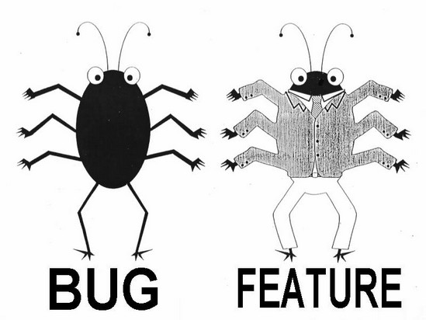
That’s all for today!
Homework #4 is due Thursday, February 11th by 9:00 a.m.

